Slide 1
Input Device: Digital Camera

Slide 2
Digital Camera
The digital camera is truly different from its predecessor. Conventional cameras depend entirely on chemical and mechanical processes -- you don't even need electricity to operate them. On the other hand, all digital cameras have a built-in computer, and all of them record images electronically.

Slide 3
Digital Camera
Digital image is just a long string of 1s and 0s that represent all the tiny colored dots -- or pixels -- that collectively make up the image.
At its most basic level, this is all there is to a digital camera. Just like a conventional camera, it has a series of lenses that focus light to create an image of a scene. But instead of focusing this light onto a piece of film, it focuses it onto a semiconductor device that records light electronically.

Slide 4
A Filmless Camera
Instead of film, a digital camera has a sensor that converts light into electrical charges. The image sensor employed by most digital cameras is a charge coupled device (CCD). Some cameras use complementary metal oxide semiconductor (CMOS) technology instead. Both CCD and CMOS image sensors convert light into electrons

Slide 5
A Filmless Camera
Sensor
Instead of film, a digital camera has a sensor that converts light into electrical charges. The image sensor employed by most digital cameras is a charge coupled device (CCD). Some cameras use complementary metal oxide semiconductor (CMOS) technology instead. Both CCD and CMOS image sensors convert light into electrons.
A simplified way to think about these sensors is to think of a 2-D array of thousands or millions of tiny solar cells. Once the sensor converts the light into electrons, it reads the value (accumulated charge) of each cell in the image.

Slide 6
Sensor Types
There are two of sensors
A CCD transports the charge across the chip and reads it at one corner of the array. An analog-to-digital converter (ADC) then turns each pixel's value into a digital value by measuring the amount of charge at each photosite and converting that measurement to binary form.

Slide 7
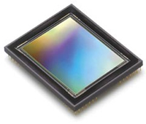
CCD Sensor

Slide 8
Sensor Types (Cont.)
CMOS devices use several transistors at each pixel to amplify and move the charge using more traditional wires. The CMOS signal is digital, so it needs no ADC

Slide 9
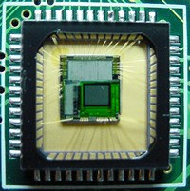
CMOS Image Sensor

Slide 10
Digital Camera Resolution
The amount of detail that the camera can capture is called the resolution, and it is measured in pixels. The more pixels a camera has, the more detail it can capture and the larger pictures can be without becoming blurry or "grainy."
Some typical resolutions include
256x256 - Found on very cheap cameras, this resolution is so low that the picture quality is almost always unacceptable. This is 65,000 total pixels.

Slide 11
Digital Camera Resolution(Cont.)
640x480 - This is the low end on most "real" cameras. This resolution is ideal for e-mailing pictures or posting pictures on a Web site.
1216x912 - This is a "megapixel" image size -- 1,109,000 total pixels -- good for printing pictures.
2240x1680 - Found on 4 megapixel cameras -- the current standard -- this allows even larger printed photos, with good quality for prints up to 16x20 inches.
4064x2704 - A top-of-the-line digital camera with 11.1 megapixels takes pictures at this resolution. At this setting, you can create 13.5x9 inch prints with no loss of picture quality

Slide 12
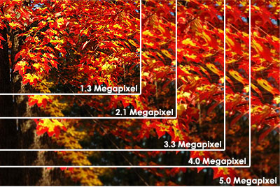
The size of an image taken at different resolutions

Slide 13
How Many Pixels?
You may have noticed that the number of pixels and the maximum resolution don't quite compute. For example, a 2.1-megapixel camera can produce images with a resolution of 1600x1200, or 1,920,000 pixels. But "2.1 megapixel" means there should be at least 2,100,000 pixels.

Slide 14
How Digital Camera Work?
Capturing Color
Unfortunately, each photosite is colorblind. It only keeps track of the total intensity of the light that strikes its surface. In order to get a full color image, most sensors use filtering to look at the light in its three primary colors. Once the camera records all three colors, it combines them to create the full spectrum.

Slide 15
How Digital Camera Work?
How the three colors mix to form many colors ?
There are several ways of recording the three colors in a digital camera. The highest quality cameras use three separate sensors, each with a different filter. A beam splitter directs light to the different sensors. Think of the light entering the camera as water flowing through a pipe. Using a beam splitter would be like dividing an identical amount of water into three different pipes. Each sensor gets an identical look at the image; but because of the filters, each sensor only responds to one of the primary colors.

Slide 16
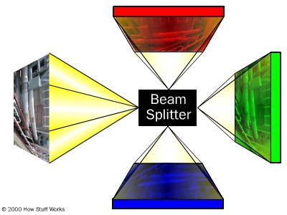
How the original (left) image is split in a beam splitter

Slide 17
Advantage of Beam Splitter
The advantage of this method is that the camera records each of the three colors at each pixel location. Unfortunately, cameras that use this method tend to be bulky and expensive

Slide 18
How Digital Camera Work? ..
Another method is to rotate a series of red, blue and green filters in front of a single sensor. The sensor records three separate images in rapid succession. This method also provides information on all three colors at each pixel location; but since the three images aren't taken at precisely the same moment, both the camera and the target of the photo must remain stationary for all three readings. This isn't practical for candid photography or handheld cameras.

Slide 19
How Digital Camera Work? ..
More on Capturing Color
A more economical and practical way to record the primary colors is to permanently place a filter called a color filter array over each individual photosite. By breaking up the sensor into a variety of red, blue and green pixels, it is possible to get enough information in the general vicinity of each sensor to make very accurate guesses about the true color at that location. This process of looking at the other pixels in the neighborhood of a sensor and making an educated guess is called interpolation.

Slide 20
How Digital Camera Work? ..
Bayer filter pattern
The most common pattern of filters is the Bayer filter pattern. This pattern alternates a row of red and green filters with a row of blue and green filters. The pixels are not evenly divided -- there are as many green pixels as there are blue and red combined. This is because the human eye is not equally sensitive to all three colors. It's necessary to include more information from the green pixels in order to create an image that the eye will perceive as a "true color."

Slide 21
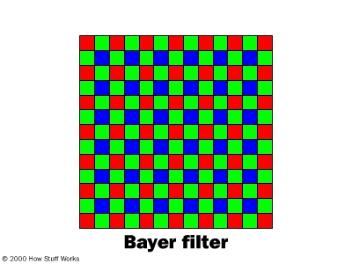
Bayer filter pattern..

Slide 22
How Digital Camera Work? ..
Bayer filter pattern (Cont.)
The advantages of this method are that only one sensor is required, and all the color information (red, green and blue) is recorded at the same moment. That means the camera can be smaller, cheaper, and useful in a wider variety of situations. The raw output from a sensor with a Bayer filter is a mosaic of red, green and blue pixels of different intensity.

Slide 23
How Digital Camera Work? ..
Bayer filter pattern (Cont.)
Digital cameras use specialized demosaicing algorithms to convert this mosaic into an equally sized mosaic of true colors. The key is that each colored pixel can be used more than once. The true color of a single pixel can be determined by averaging the values from the closest surrounding pixels. .

Slide 24
How Digital Camera Work? ..
Exposure and Focus
Just as with film, a digital camera has to control the amount of light that reaches the sensor. The two components it uses to do this, the aperture and shutter speed, are also present on conventional cameras.

Slide 25
How Digital Camera Work? ..
Exposure and Focus (Cont.)
Aperture: The size of the opening in the camera. The aperture is automatic in most digital cameras, but some allow manual adjustment to give professionals and hobbyists more control over the final image.

Slide 26
How Digital Camera Work? ..
Exposure and Focus (Cont.)
Shutter speed: The amount of time that light can pass through the aperture. Unlike film, the light sensor in a digital camera can be reset electronically, so digital cameras have a digital shutter rather than a mechanical shutter.

Slide 27
How Digital Camera Work? ..
Exposure and Focus (Cont.)
These two aspects work together to capture the amount of light needed to make a good image. In photographic terms, they set the exposure of the sensor. In addition to controlling the amount of light, the camera has to adjust the lenses to control how the light is focused on the sensor. In general, the lenses on digital cameras are very similar to conventional camera lenses -- some digital cameras can even use conventional lenses.

Slide 28
How Digital Camera Work? ..
Exposure and Focus (Cont.)
The focal length, however, is one important difference between the lens of a digital camera and the lens of a 35mm camera. The focal length is the distance between the lens and the surface of the sensor. Sensors from different manufacturers vary widely in size, but in general they're smaller than a piece of 35mm film. In order to project the image onto a smaller sensor, the focal length is shortened by the same proportion.

Slide 29
How Digital Camera Work? ..
Exposure and Focus (Cont.)
Focal length also determines the magnification, or zoom, when you look through the camera. In 35mm cameras, a 50mm lens gives a natural view of the subject. Increasing the focal length increases the magnification, and objects appear to get closer. The reverse happens when decreasing the focal length. A zoom lens is any lens that has an adjustable focal length, and digital cameras can have optical or digital zoom -- some have both. Some cameras also have macro focusing capability, meaning that the camera can take pictures from very close to the subject.

Slide 30
How Digital Camera Work? ..
Digital cameras have one of four types of lenses:
Fixed-focus, fixed-zoom lenses-
These are the kinds of lenses on disposable and inexpensive film cameras -- inexpensive and great for snapshots, but fairly limited.

Slide 31
How Digital Camera Work? ..
2. Optical-zoom lenses with automatic focus –
Similar to the lens on a video camcorder, these have "wide" and "telephoto" options and automatic focus. The camera may or may not support manual focus. These actually change the focal length of the lens rather than just magnifying the information that hits the sensor.

Slide 32
How Digital Camera Work? ..
3. Digital-zoom lenses –
With digital zoom, the camera takes pixels from the center of the image sensor and interpolates them to make a full-sized image. Depending on the resolution of the image and the sensor, this approach may create a grainy or fuzzy image. You can manually do the same thing with image processing software -- simply snap a picture, cut out the center and magnify it.

Slide 33
How Digital Camera Work? ..
4. Replaceable lens systems –
These are similar to the replaceable lenses on a 35mm camera. Some digital cameras can use 35mm camera lenses.

Slide 34
How Digital Camera Work? ..
Storing Digital Photos
Early generations of digital cameras had fixed storage inside the camera. You needed to connect the camera directly to a computer with cables to transfer the images. Although most of today's cameras are capable of connecting through serial, parallel, SCSI, USB or FireWire connections, they usually also use some sort of removable storage device.

Slide 35
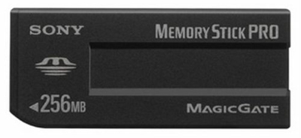
How Digital Camera Work? ..
A memory stick

Slide 36
How Digital Camera Work? ..
Storing Digital Photos
Digital cameras use a number of storage systems. These are like reusable, digital film, and they use a caddy or card reader to transfer the data to a computer. Many involve fixed or removable flash memory. Digital camera manufacturers often develop their own proprietary flash memory devices, including SmartMedia cards, CompactFlash cards and Memory Sticks.

Slide 37
How Digital Camera Work? ..
Storing Digital Photos
No matter what type of storage they use, all digital cameras need lots of room for pictures. They usually store images in one of two formats -- TIFF, which is uncompressed, and JPEG, which is compressed, but some use RAW format. Most cameras use the JPEG file format for storing pictures, and they sometimes offer quality settings (such as medium or high). The following chart will give you an idea of the file sizes you might expect with different picture sizes.

Slide 38
How Digital Camera Work? ..
Storing Digital Photos
No matter what type of storage they use, all digital cameras need lots of room for pictures. They usually store images in one of two formats -- TIFF, which is uncompressed, and JPEG, which is compressed, but some use RAW format. Most cameras use the JPEG file format for storing pictures, and they sometimes offer quality settings (such as medium or high).

Slide 39
How Digital Camera Work? ..
Storing Digital Photos
To make the most of their storage space, almost all digital cameras use some sort of data compression to make the files smaller. Two features of digital images make compression possible. One is repetition. The other is irrelevancy.

Slide 40
How Digital Camera Work? ..
Storing Digital Photos
Imagine that throughout a given photo, certain patterns develop in the colors. For example, if a blue sky takes up 30 percent of the photograph, you can be certain that some shades of blue are going to be repeated over and over again. When compression routines take advantage of patterns that repeat, there is no loss of information and the image can be reconstructed exactly as it was recorded. Unfortunately, this doesn't reduce files any more than 50 percent, and sometimes it doesn't even come close to that level .

Slide 41
How Digital Camera Work? ..
Storing Digital Photos
Irrelevancy is a trickier issue. A digital camera records more information than the human eye can easily detect. Some compression routines take advantage of this fact to throw away some of the more meaningless data.

Slide 42
How Digital Camera Work? ..
Summary
It takes several steps for a digital camera to take a picture. Here's a review of what happens in a CCD camera, from beginning to end:
You aim the camera at the subject and adjust the optical zoom to get closer or farther away.
You press lightly on the shutter release.
The camera automatically focuses on the subject and takes a reading of the available light

Slide 43
How Digital Camera Work? ..
Summary
The camera sets the aperture and shutter speed for optimal exposure.
You press the shutter release all the way.
The camera resets the CCD and exposes it to the light, building up an electrical charge, until the shutter closes.
The ADC measures the charge and creates a digital signal that represents the values of the charge at each pixel.

Slide 44
How Digital Camera Work? ..
Summary
A processor interpolates the data from the different pixels to create natural color. On many cameras, it is possible to see the output on the LCD at this stage.
A processor may perform a preset level of compression on the data.
The information is stored in some form of memory device (probably a Flash memory card).

